Slide 1
Data Structures and Algorithms IICT-6005
Lesson 15 – Doubly Linked Lists

Slide 2
Lesson Content
Doubly Linked Lists
The Node class
Comparison with the Singly Linked List
Operations on Doubly Linked Lists

Slide 3
Doubly Linked Lists
Doubly linked lists are very similar to singly linked lists.
The difference is that nodes in doubly linked lists will have a reference to both the Next node (like in a singly linked list) and also to the Previous node.

Slide 4
The Node class
Previous: Node
Element: object
Next: Node
A

Slide 5
Comparison with the Singly Linked List
In singly linked lists, obtaining the Previous Node from the Cursor was an expensive operation ( O(n) time ).
Doubly linked lists are able to implement this method and other methods that would be inefficient due to this operation more efficiently.
Due to the direct reference, finding the Previous Node takes O(1) time.

Slide 6
Comparison with the Singly Linked List
The Doubly linked list has twice the amount of references to maintain.
This results in more complex operations.
It also means that since twice as many references need to be updated, operations that are efficient in both singly linked lists and doubly linked lists may take up to twice as much time to execute in doubly linked lists.

Slide 7
Doubly Linked Lists
Head of list Head : Node
The size of the list Size : Integer
The element is the object being stored within the node.
B
5
A
Next : Node
In a Singly Linked List, each node has an element and a link to the next node.

Slide 8
Doubly Linked Lists
Head of list Head : Node
The size of the list Size : Integer
2
∅
∅
A
B

Slide 9
Operations on Doubly Linked Lists
Consider the following operations on the Double Linked List:
void InsertFirst(object Element)
object RemoveFirst( )
void InsertAfter(Node Cursor, object Element)
object RemoveAfter(Node Cursor)

Slide 10
Insert First
Head of list Head : Node
The size of the list Size : Integer
2
∅
∅
A
B

Slide 11
Insert First
Head of list Head : Node
The size of the list Size : Integer
2
∅
∅
Element
∅
∅
A
B

Slide 12
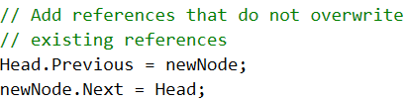
Insert First
Head of list Head : Node
The size of the list Size : Integer
2
∅
∅
Element
∅
∅
A
B

Slide 13
Insert First
What happens if the list was empty?
Head of list Head : Node
The size of the list Size : Integer
2
∅
Element
∅
A
B

Slide 14

Insert First
Head of list Head : Node
The size of the list Size : Integer
3
2
∅
Element
∅
A
B

Slide 15
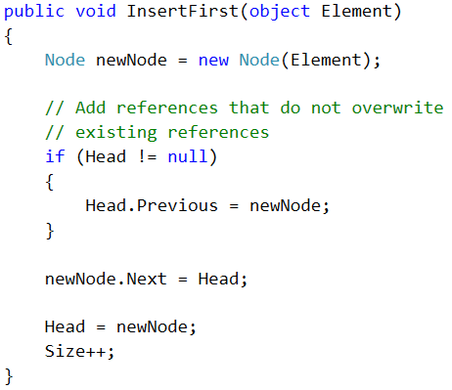
Insert First

Slide 16
Remove First
Exercise:
Implement the Remove First
Hint:
You need to cater for the following special cases:
The list is empty;
The list contains only one node, which is the head; and
The list contains two or more nodes.

Slide 17
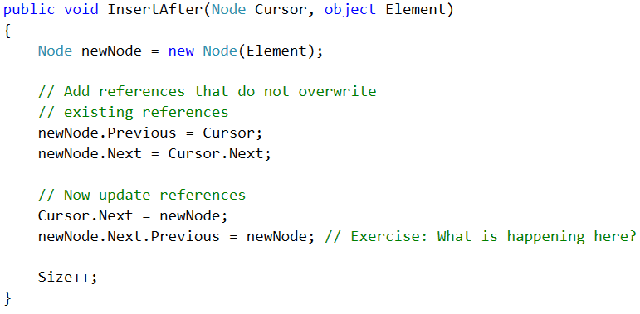
Insert After

Slide 18
Insert After
Exercise:
Work out what is going on in the following line of code:
newNode.Next.Previous = newNode;
Draw a set of diagrams representing the operation InsertAfter

Slide 19
Remove After
Exercise:
Work out how to remove the Node after the Cursor and return its Element.
Careful: Make sure you avoid NullReferenceExceptions!

Slide 20
Remove Current Node
Exercise:
Given that you have a Cursor, how would you use the existing RemoveAfter operation to remove the Current Node?
Hint: Use the RemoveAfter operation within the new operation.
Hint: There is a special case when the Cursor is the head of the list.

Slide 21
Insert Last and Remove Last
Exercise:
Identify how to create a method that allows you to insert a node at the tail of the list (the end of the list) and to remove a node at the tail of the list efficiently.
You may use existing operations.
You may also require to add a special Cursor that points to the tail of the list and update it when carrying out these and other operations.

Slide 22
Summary
Doubly Linked Lists
The Node class
Comparison with the Singly Linked List
Operations on Doubly Linked Lists

Slide 23
End of lesson
Any questions?

